Slide 1
Data Protection: the Data Protection Act 1998 and the GDPR, data protection present and future
Museums + Heritage webinar, 30 November 2017
Richard Sisson, ICO, Policy and Engagement Department (Private and Third Sector)

Slide 2
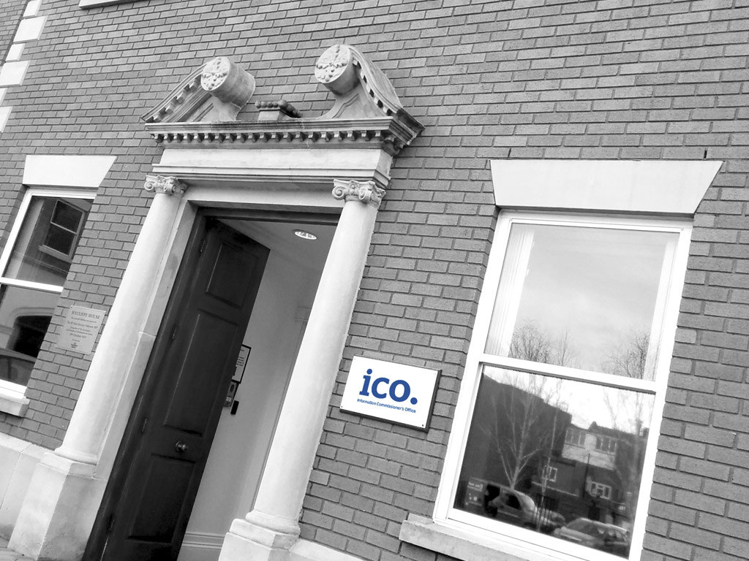
About us …
…and this session

Slide 3
Data Protection Act 1998 (the DPA)
Legislation designed to protect individuals
Principles based legislation – Easiest way to understand the DPA is to review its principles, foundation of compliance with the DPA
  You must use personal data fairly and lawfully and you must have a basis for using it
  You should only use personal data for a specified and lawful purpose
  The personal data you use must be adequate, relevant and not excessive for the reasons you are using it
  The personal data you use must be accurate and kept up to date where necessary
  You should only keep personal data for as long as is necessary
  When using personal data you must do so in line with individual’s data protection rights
  You must have appropriate measures in place to safeguard the security of personal data
  Personal data must not be sent outside of the EEA unless the country its going to has adequate protections in place

Slide 4

EU General Data Protection Regulation:
Background and purpose

Slide 5

Counting down to
25 May 2018

Slide 6
DPA vs GDPR….
Similarities:
evolution not revolution
principles based
still rights for individuals
still responsibilities for organisations
ICO still regulator in UK
still a number of grounds to justify processing – including consent

Slide 7
DPA vs GDPR….
Differences:
greater emphasis on control and rights for data subjects
clarified definition of personal data
consent
transparency & accountability
data processor obligations
administrative fines
sources of advice and guidance

Slide 8
Focus on accountability
Data controllers will be responsible for demonstrating their compliance.
Some new requirements:
Data protection impact assessments (DPIAs)
Data protection officers (DPOs)
Recording processing activities
Demonstrating consent
Data protection by design
Adherence to approved codes of conduct or certification mechanisms can help to demonstrate compliance with data controller obligations.

Slide 9

What personal data do you process?
Definition of personal data
Same as under DPA but with certain items specified including:
Location data
Online identifiers (e.g. IP or MAC addresses)
What constitutes processing?
Operations or set of operations performed on personal data
Not limited to automated operations
Article 4(2) sets out a range of operations

Slide 10
Identifying a basis for processing
GDPR increases the emphasis on identifying and explaining your legal basis for processing.
Consent is not the only basis:
Contracts
Legal obligations
Protecting the vital interests of the data subject or another person
Carrying out public/official functions
Legitimate interests of data controllers or third parties
Special categories of data (i.e. sensitive personal data), require a further basis under Article 9.

Slide 11
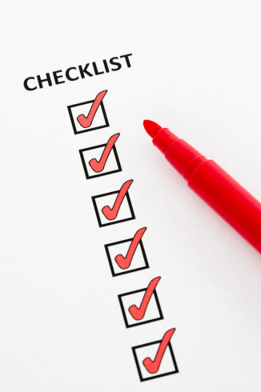
Consent
Clear and affirmative action = not a pre-ticked box, silence or inactivity
Easy to distinguish = not buried in T&Cs
Freely given = cannot be an imbalance between parties
Need to demonstrate consent obtained
Unambiguous
e-Privacy Regulation consent will be based on GDPR consent

Slide 12

Withdrawing consent
Must be able to withdraw consent at any time
Consent must be as easy to withdraw as to give
Have to tell data subject they have ability to withdraw consent

Slide 13
Privacy notices & transparency
Data subject to be told what their data will be used for, by whom, when, how and where - extension of principle 1 requirement under DPA.
Information given must be
concise
transparent
intelligible
in an easily accessible format
in clear and plain language

Slide 14
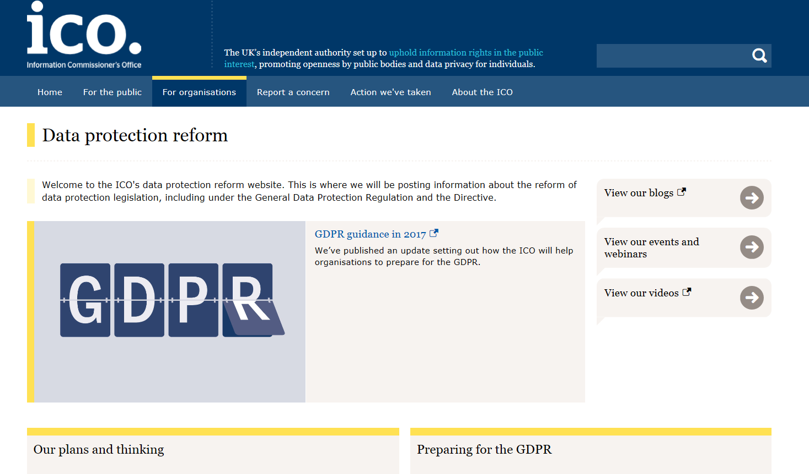
ICO guidance
https://ico.org.uk/for-organisations/data-protection-reform/
Sign up to our newsletter: www.ico.org.uk/about-the-ico/news-and-events/e-newsletter/

Slide 15
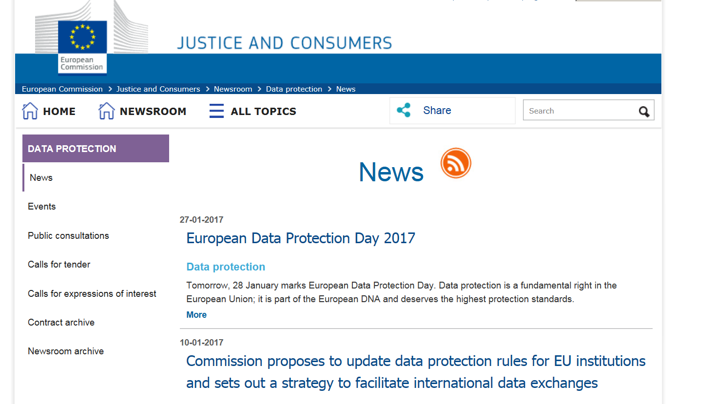
Article 29 Working Party guidance
www.ec.europa.eu/newsroom/just/news.cfm?tpa_id=2026

Slide 16




Keep in touch
Subscribe to our e-newsletter at www.ico.org.uk
or find us on…
/iconews
@iconews

